Slide 1


A Central Website for R:
r-community.org
A presentation by: Ben C. Ubah, Rick Pack,
Meet Bhatnagar, João Vitor Cavalcante
Notes:
Hello my name is Rick Pack and I am excited to speak on behalf of lead developer Ben Ubah a central website for tracking the global R open source community and ecosystem: r-community.org. This work is a continuation of work presented during useR2020 and counts as its contributors Ben and I’s Google Summer of Code 2021 mentees, Meet Bhanagar and Joao Vitor Cavalcante. Link to R Community Explorer – useR2020 video - https://www.youtube.com/watch?v=7F7iQdcV8RY&t=247s

Slide 2
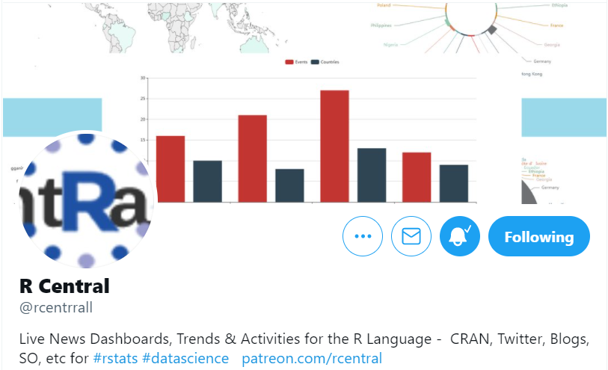
r-community.org Data-Driven Exploration of the R Community
Includes pages from and added to Ben Ubah’s “R Community Explorer” during Google Summer of Code 2021 - R Events with a calendar - CRAN packages - RStudio Community - satRdays - Twitter - Stack Overflow - R-Bloggers And more…
Notes:
r-community.org includes pages from and added to Ben Ubah’s “R Community Explorer” during Google Summer of Code 2021 - R Events with a calendar - CRAN packages - RStudio Community - satRdays - Twitter - Stack Overflow - R-Bloggers And more…
Many navigation and interactive elements are common between many of the pages as we will demonstrate later. Please consider following Ben at twitter handle rcentrrall with two Rs and two Ls as well as other work with which he and collaborates are engaged like tracking useR2021 activity.

Slide 3
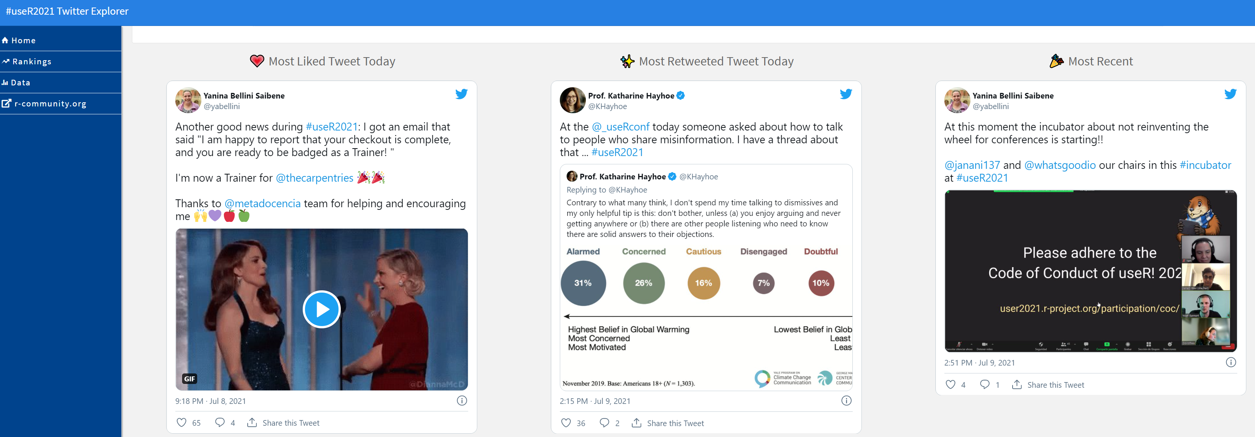
https://r-community.github.io/user-tweets/
Notes:
Ben Ubah and team recently added a page to see activity concerning #useR2021! I am happy to be able to honor the most liked tweet today that recognizes hard-working useR2021 organizer Yanina Bellini Saibene, who was just named as a trainer for @thecarpentries.
The #useR2021 page can currently only be accessed directly at https://r-community.github.io/user-tweets/.

Slide 4
Why r-community.org?
1. Help users, new and experienced, connect with each other 2. Show R language usage trends (think training programs) 3. Motivate targeted assistance including where there are geographic disparities and common challenges 3. Boost attendance of events such as workshops and R Meetups
Notes:
Why r-community.org? 1. Help users, new and experienced, connect with each other 2. Show R language usage trends (think training programs) 3. Motivate targeted assistance including where there are geographic disparities and common challenges 3. Boost attendance of events such as workshops and R Meetups
1. Help users, new and experienced, connect with each other 2. See R language usage trends (think training programs) 3. Motivate targeted assistance including where there are geographic disparities and common challenges 3. Boost attendance of events such as workshops and R Meetups

Slide 5
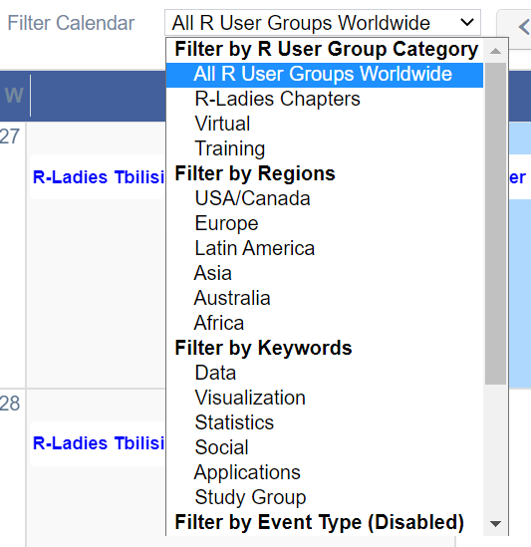
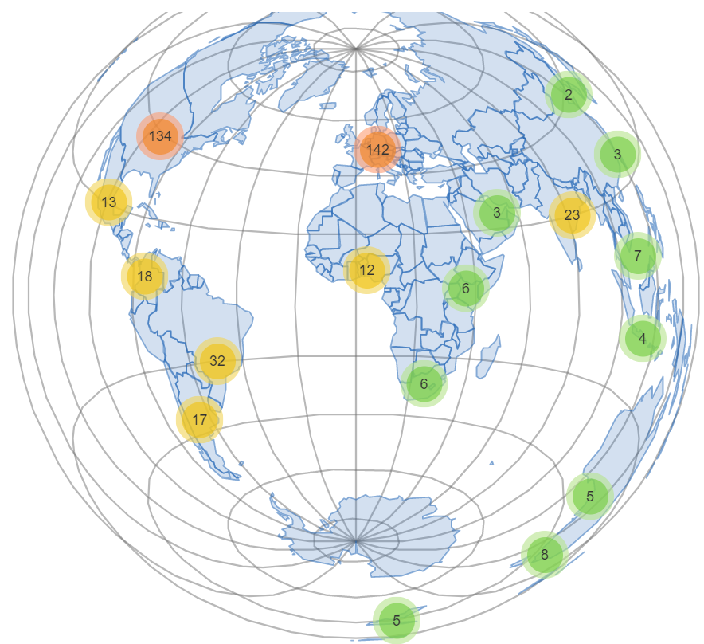
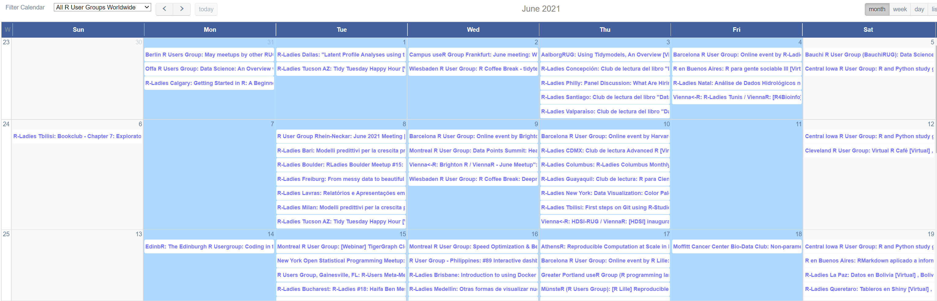
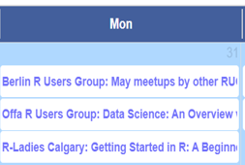
Calendar Exploring R Events | by Groups that identify R as one of their topics of interest on Meetup.com
Data Collected: June 28, 2021
Notes:
Among the R Events page is a Calendar that automatically updates using data acquired through Meetup.com. Ben Ubah is in communications with a potential partner to handle non-meetup events.

Slide 6
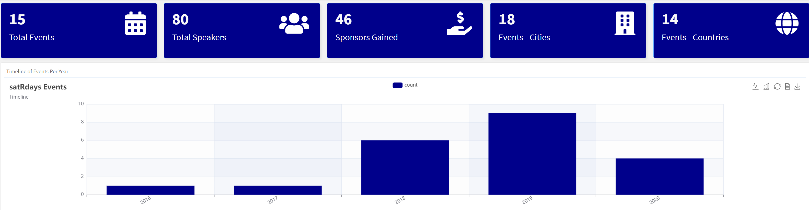
satRdays Free R Conferences | Locally organized and not for profit
Data Collected: June 28, 2021
Notes:
satRdays are free R conferences that have become particularly more frequent since 2018. We see at the top data that include number of sponsors and cities hosting the conferences.

Slide 7
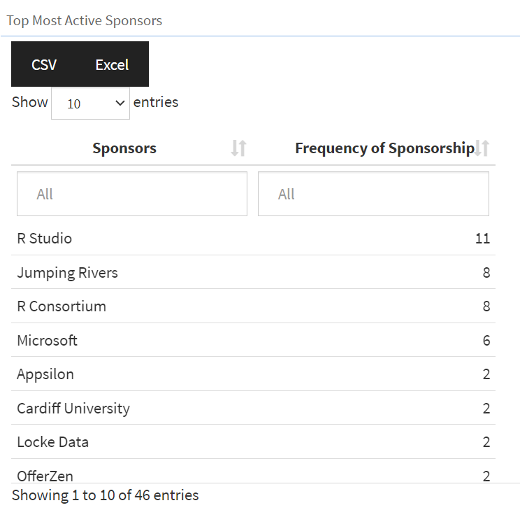
satRdays Free R Conferences | Locally organized and not for profit
Data Collected: June 28, 2021
Notes:
Scrolling down pages can reveal details such as, in this case, sponsors and how often sponsors have sponsored R Conferences. Frequent sponsors include R Studio, Jumping Rivers, and R Consortium.

Slide 8
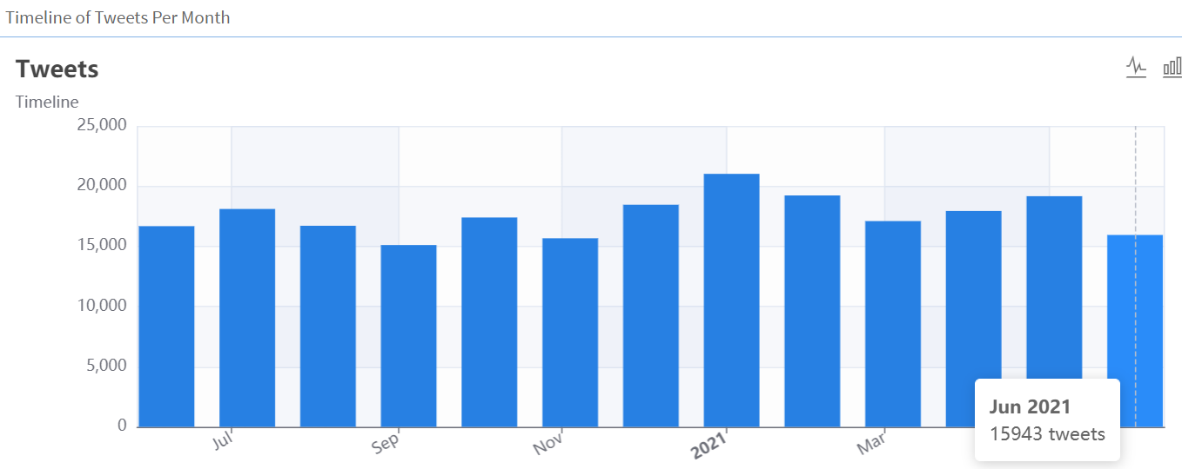
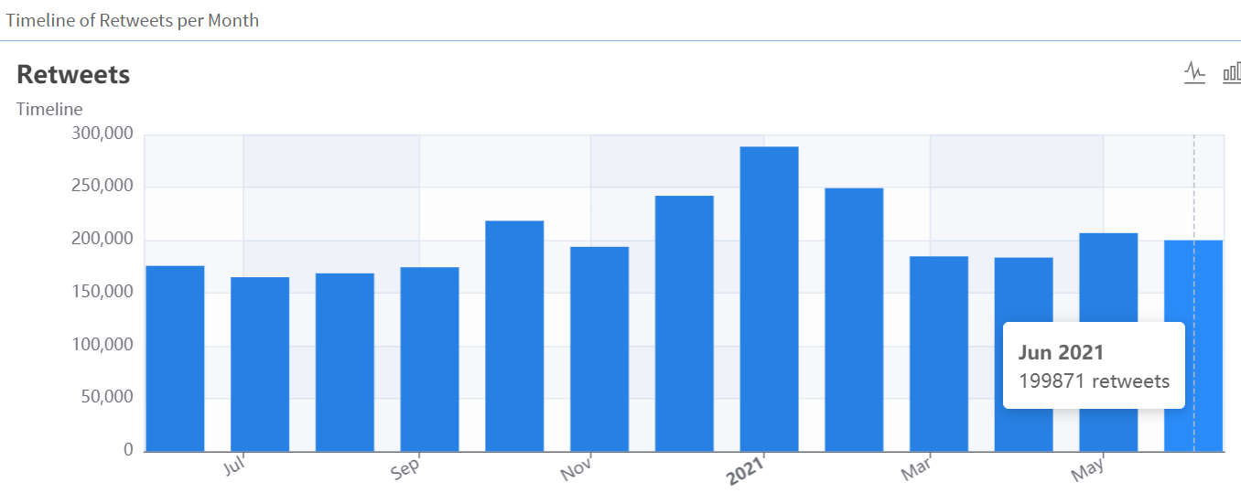
Twitter Connecting R users | June 2020 – June 2021
Data Collected: June 28, 2021
Notes:
The Twitter page display #rstats activity. As you probably know, #rstats is a frequently used Twitter hashtag to denote Tweets (quick messages on Twitter.com) related to R. We see here plenty of activity with thousands of Tweets every month. This R-community.org dashboard helps to get a more concise sense of that activity when one scrolls down.

Slide 9
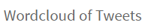
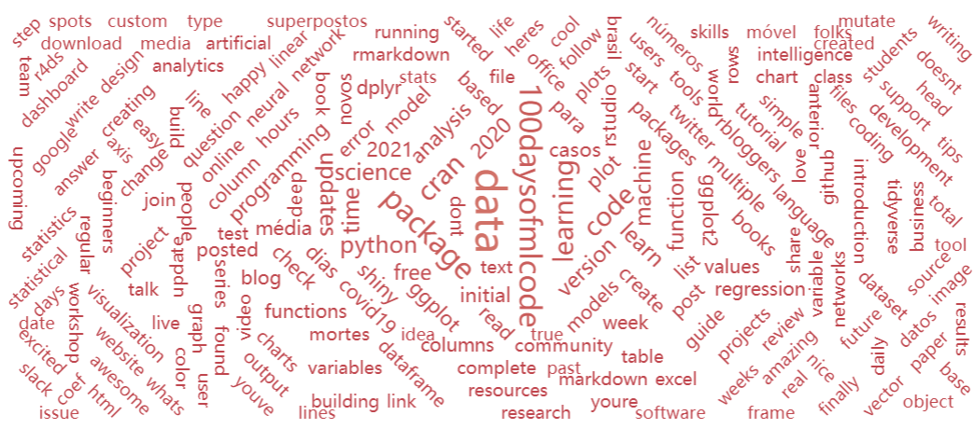
Data Collected: June 28, 2021
Notes:
Scrolling down shows a wordcloud or R tweets so one can learn more about what is popular in tweets.

Slide 10
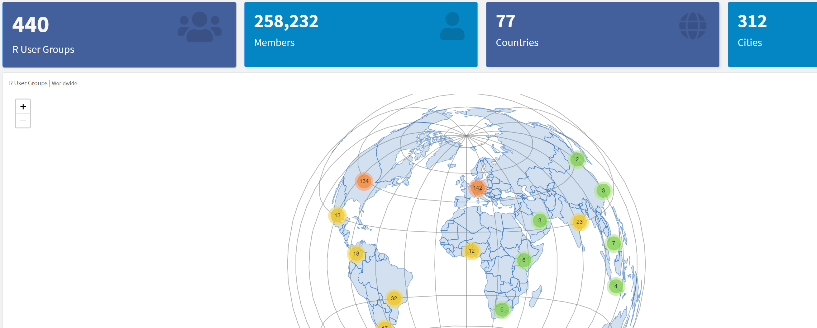
Groups Exploring R User-groups | Groups that identify R as one of their topics of interest on Meetup.com
Data Collected: June 28, 2021
Notes:
The R user-groups page shows you summaries concerning groups that include R among their topics of interest and currently acquires data only through Meetup.com. We see R’s international presence in this image with opportunities for growth in places like Africa, the Middle East, and Latin America as the prior presenter may have addressed.

Slide 11
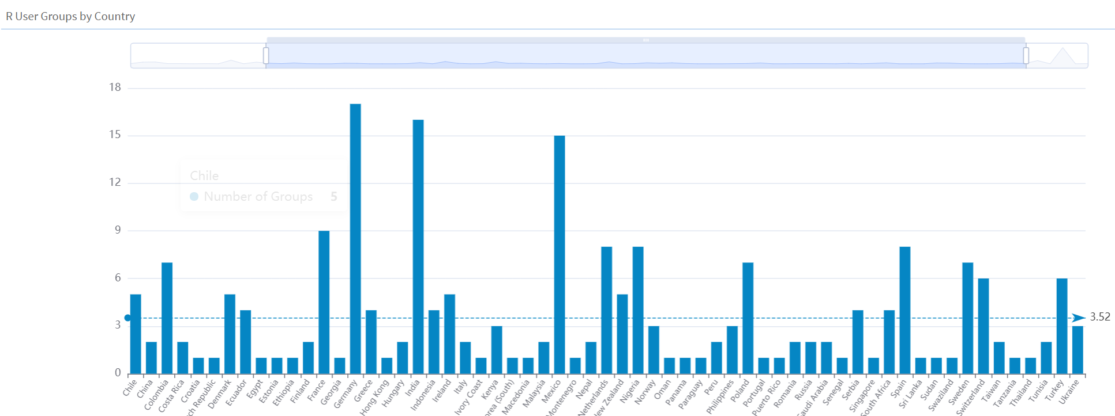
Groups Exploring R User-groups | Groups that identify R as one of their topics of interest on Meetup.com
Data Collected: June 28, 2021
Notes:
This bar chart also communicates the international presence of R groups through a chart depicting countries and the number of groups per country. One can zoom in using click-and-drag, which is hinted at by the arrow.

Slide 12
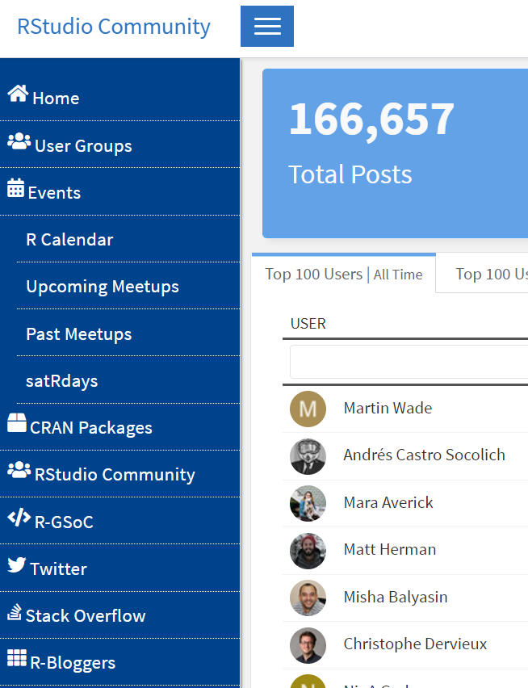
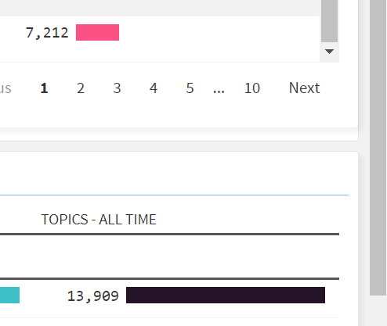
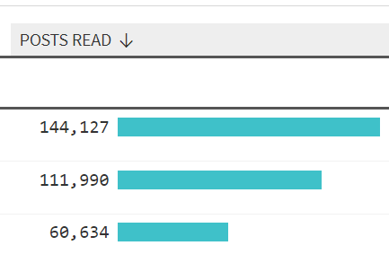
Navigating r-community.org
Button may not yet be active
Clicking any entry on the left navigation bar will open a new dashboard screen
CLICK and discover!
Clicking arrows causes sorting
Scroll down for more content
Notes:
Many interactive elements are common between the r-community.org pages. Clicking arrows causes sorting. Clicking any entry on the left navigation bar will open a new dashboard screen. Scroll down for more content.

Slide 13
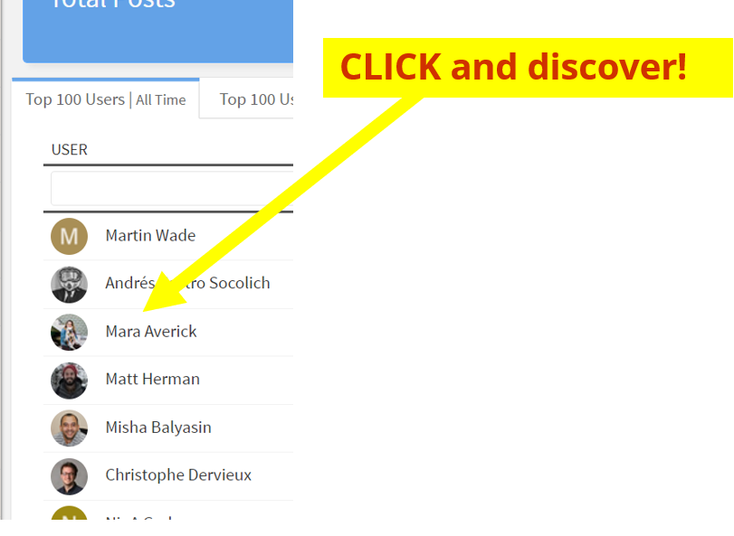
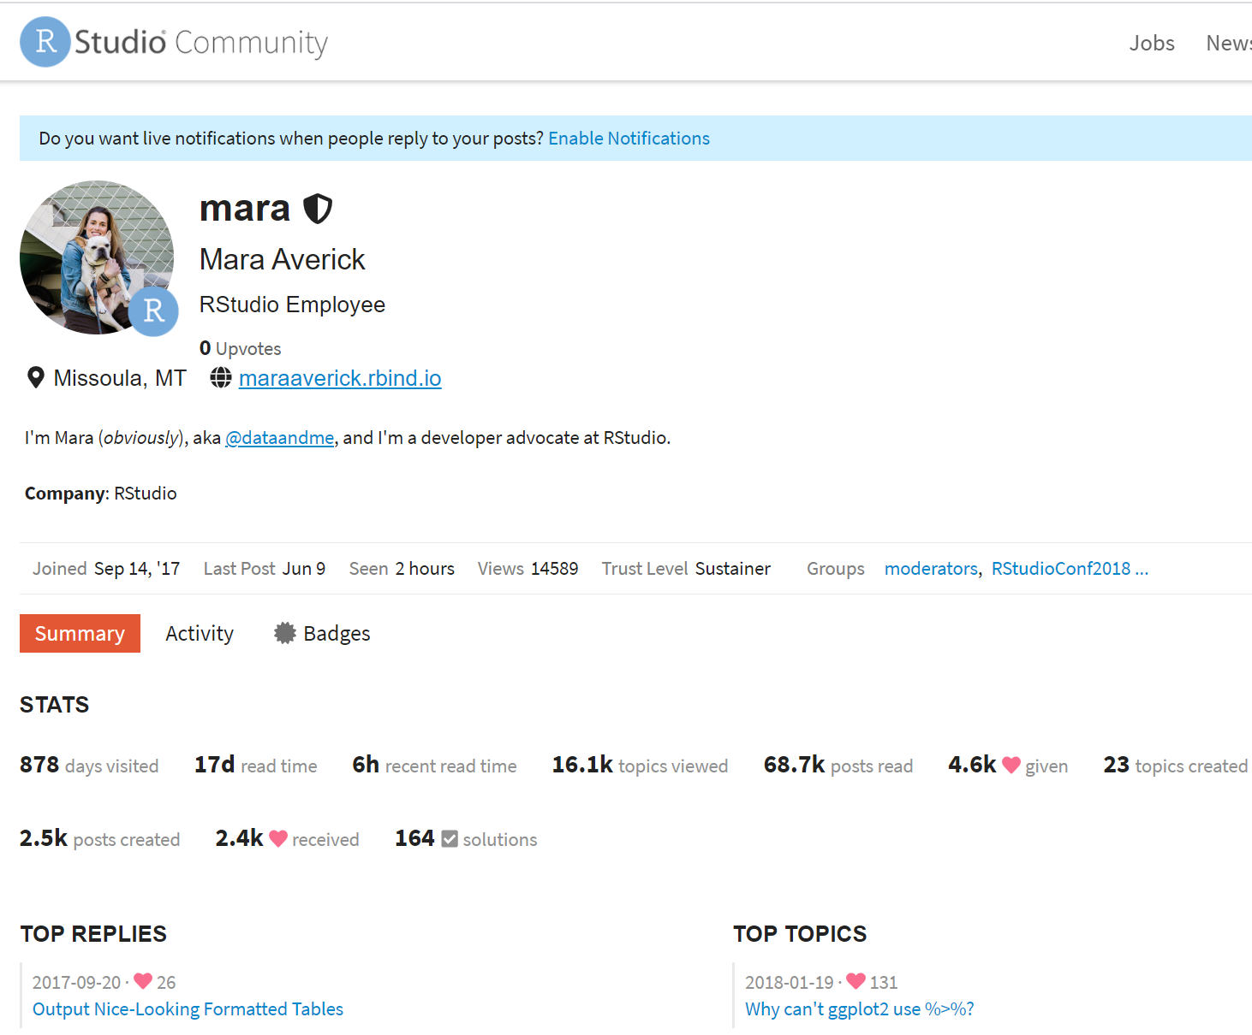
Navigating r-community.org | CLICK and discover!
CLICK
Notes:
Many interactive elements are common between the r-community.org pages. For example, CLICK and discover! At the left of the R Studio Community page are top users of the R Community. Clicking any name such as popular R advocate, Mara Averick’s, name reveals her R Studio Community activity. We see how active she has been in our community with 2 and a half thousand posts created and, I’ll say, thousands more Tweets. Thank you, Mara, a helpful R Studio employee.

Slide 14
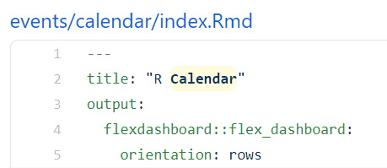
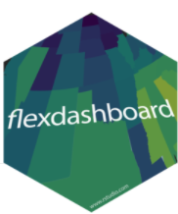

How r-community.org?
Notes:
The dashboards are now powered by R Studio’s Flexdashboard thanks to the work done during Google Summer of Code 2021.

Slide 15
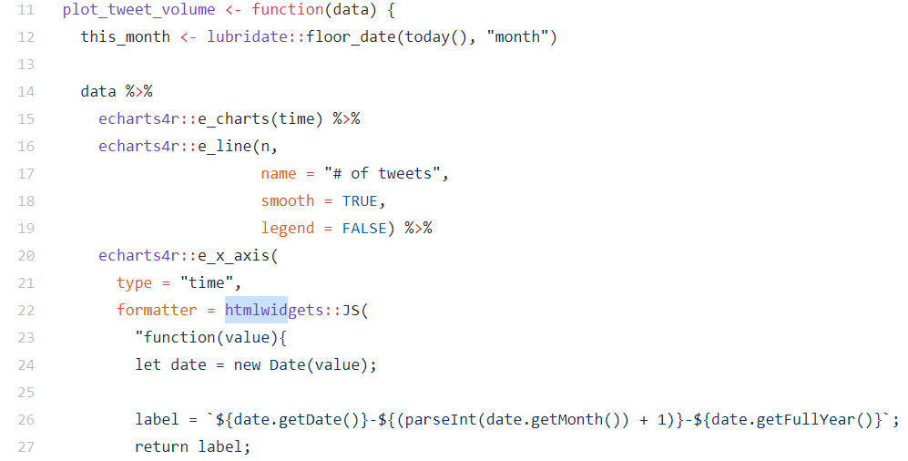
How r-community.org?
Notes:
Among the other packages used to develop the dashboard are echarts4r to aid with interactive visualizations and htmlwidgets. All of the code for r-community.org is available on Github. URLs containing the code include:
https://github.com/r-community
https://github.com/meetdarkpow/central https://github.com/jvfe/rstatsDashboard

Slide 16
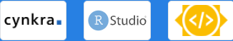
Sponsors
Notes:
At the bottom of every screen are the sponsors. Thank you to Cynkra, an R consulting business, R Studio, and Google Summer of Code.

Slide 17
Notes
Issues are welcome: https://github.com/r-community/central/issues
User groups: If you do not see your group, please open an issue
R Calendar - if you do not find your meetup events listed, please open an issue
If you admin an org and want to add your events, consider becoming a sponsor
Notes:
A few notes about r-community.org: Issues are welcome: https://github.com/r-community/central/issues
Usergroups: If you don't see your group, please open an issue
R Calendar - if you don't find your meetup events listed, please open an issue
If you admin an org and want to add your events, consider becoming a sponsor

Slide 18
Thank you!
A Central Website for R:
r-community.org
https://r-community.github.io/user-tweets/
A presentation by: Ben C. Ubah, Rick Pack,
Meet Bhatnagar, João Vitor Cavalcante
Notes:
We thank you for your time. A reminder to use https://r-community.github.io/user-tweets/ to see the new #useR2021 Twitter hashtag page celebrating Tweets about this exciting global conference, useR! 2021.

